Slide 1


EnergyPal with Team Sunshine
Solar Proposal
April 23, 2024

Slide 2
9.775 kW Q Cells Q.TRON BLK m-G2+ 425 Solar Panels
23 Solar Panels with Inverter
Est. year 1 production 9,884 kWh
Est. Energy Offset 56%
Solar size 9.78 kW
Warrantied to be 90.58% original efficiency at year 25

Slide 3
System Size: 9.775 kw
Modules: 23 Q Cells Q. TRON BLK M-G2+ 425
Inverter: 23 Enphase IQ8+ Microinverter
Monitor: Enphase ENV-IQ-AM1-240M / CELLMODEM-01 M
Racking: All racking and hardware necessary for connection of PV system
Electrical: All electrical supplies necessary for connection of PV modules to DC inverter to AC main supply feed
Labor: All necessary for design and installation of PV system
Permits: All building and electrical permits necessary for installation of PV system
Other: Site Survey

Slide 4
Panels warranted by manufactures
Team Sunshine guarantees production of at least 85% for 10 years of the estimated year 1 production for 10 years. Estimated year 1 production is 9828
Every year after year 1, the guaranteed production number will decrease by an amount of .5% per year for each year
If at the Anniversary Date the System has generated less than the kwh guaranteed in the prior year the Company will pay the difference in kwh at a rate of $.15/kwh

Slide 5
Sign Document ~ 10% of Total Price
Review & Refer
Site Survey & Plans ~ 40% of Total Price at equipment order
Permits . . . .
Install
System Activation ~ 50% or Balance of Contract Due at Construction completion
Purchase Cash $30,283

Slide 6
Borrow $31,000 from our capital Reserve
ROI within 10 years *
No increase in budget
No assessment
No increase in condo fee
Does not reflect any electric rate increases
Does not reflect Net Metering
* Refer to spreadsheet

Slide 7
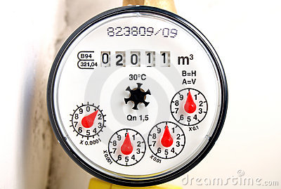
We have 7 Liberty meters at $14.74/month = $1,85/year *
19B Hadleigh (pump house) is our main meter
25 Flat Rock – Hunter Box (irrigation)
10, 25, 30, 36 Hadleigh Hunter Boxes
42 Hadleigh – Lift station
* Refer to spreadsheet
Using 2023 figures:
Total usage of 6 meters = $111
Average $43/ year or $3.75/month
Eliminating 6 meters would save us $973

